Slide 1
Travelling Salesman Problem

Slide 2

This humorously named problem refers to the following situation:
A travelling salesman, named Rover plans to visit each of n cities. He wishes to visit each city once and only once, arriving back to city from where he started. The distance between City i and City j is c_{ij}. What is the shortest tour Rover can take?
If there are n cities, there are (n - 1)! possible ways for his tour. For example, if the number of cities to be visited is 5, then there are 4! different combinations. Such type of problems can be solved by the assignment method.
Let c_{ij} be the distance (or cost or time) between City i to City j and
 | A | B | C | D
A | ∞ | 25 | 75 | 45
B | 35 | ∞ | 150 | 25
C | 35 | 40 | ∞ | 15
D | 65 | 75 | 130 | ∞
The following example will help you in understanding the travelling salesman problem of operation research.
Ref: http://www.universalteacherpublications.com/univ/ebooks/or/Ch6/travsales.htm

Slide 3
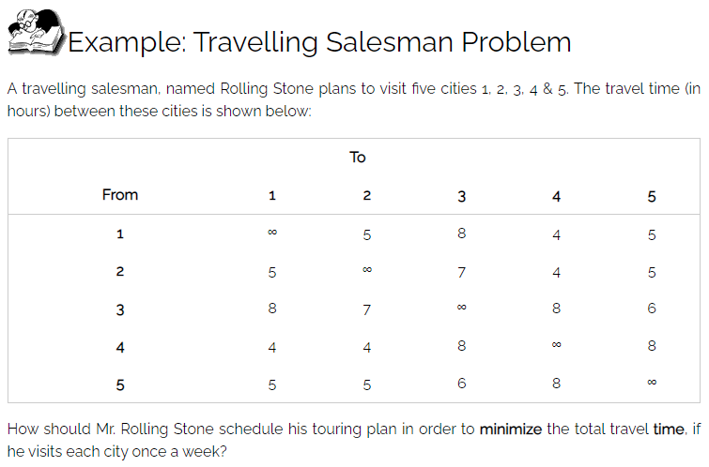
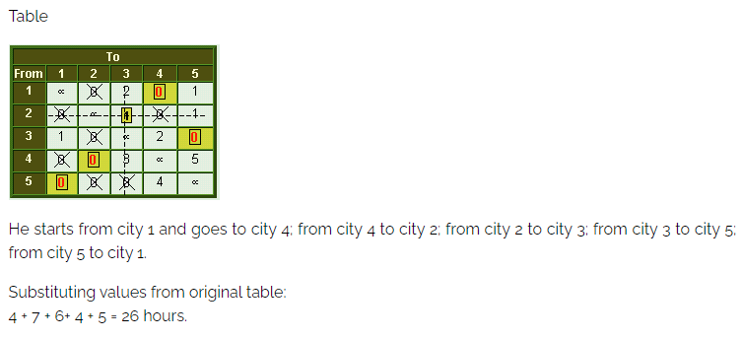
The salesman starts from his home city he must visit every city exactly once and return to his home city.

Slide 4
Phase I:
TSP can be first solved as Assignment Problem by using Hungarian Method to find optimum solution.
Then check the TSP condition.
If the condition is satisfied the AP solution will be the optimum solution even for TSP.
If not, go to
Phase II:
The solution can be adjusted by inspection
Form a single circuit
The iterative procedure
Branch and bound method

Slide 5
Row Reduction
 | A | B | C | D
A | ∞ | 0 | 50 | 20
B | 10 | ∞ | 125 | 0
C | 20 | 25 | ∞ | 0
D | 0 | 10 | 65 | ∞
 | A | B | C | D
A | ∞ | 25 | 75 | 45
B | 35 | ∞ | 150 | 25
C | 35 | 40 | ∞ | 15
D | 65 | 75 | 130 | ∞
 | A | B | C | D
A | ∞ | 0 | 0 | 20
B | 10 | ∞ | 75 | 0
C | 20 | 25 | ∞ | 0
D | 0 | 10 | 15 | ∞
Column Reduction

Slide 6
 | A | B | C | D
A | ∞ | 0 | 0 | 20
B | 10 | ∞ | 75 | 0
C | 20 | 25 | ∞ | 0
D | 0 | 10 | 15 | ∞
 | A | B | C | D
A | ∞ | 0 | 0 | 20
B | 10 | ∞ | 75 | 0
C | 20 | 25 | ∞ | 0
D | 0 | 10 | 15 | ∞

Slide 8
The solution can be adjusted by inspection
Trial and error
Minimum other than 0
Trial and error ​
 | A | B | C | D | E
A | ∞ | 2 | 5 | 8 | 1
B | 6 | ∞ | 3 | 9 | 2
C | 8 | 7 | ∞ | 4 | 8
D | 13 | 4 | 7 | ∞ | 5
E | 1 | 3 | 2 | 8 | ∞
 | A | B | C | D | E
A | ∞ | 1 | 3 | 7 | 0
B | 4 | ∞ | 0 | 7 | 0
C | 4 | 3 | ∞ | 0 | 4
D | 9 | 0 | 2 | ∞ | 1
E | 0 | 2 | 1 | 7 | ∞

Slide 9
 | A | B | C | D | E
A | ∞ | 1 | 3 | 7 | 0
B | 4 | ∞ | 0 | 7 | 0
C | 4 | 3 | ∞ | 0 | 4
D | 9 | 0 | 2 | ∞ | 1
E | 0 | 2 | 1 | 7 | ∞
 | A | B | C | D | E
A | ∞ | 1 | 3 | 7 | 0
B | 4 | ∞ | 0 | 7 | 0
C | 4 | 3 | ∞ | 0 | 4
D | 9 | 0 | 2 | ∞ | 1
E | 0 | 2 | 1 | 7 | ∞

Slide 11
Form a single circuit
 | A | B | C | D | E
A | ∞ | 1 | 3 | 7 | 0
B | 4 | ∞ | 0 | 7 | 0
C | 4 | 3 | ∞ | 0 | 4
D | 9 | 0 | 2 | ∞ | 1
E | 0 | 2 | 1 | 7 | ∞
A -> E = 1
B -> C = 3
C -> D = 4
D -> B = 4
E -> A = 1
TOTAL =13
A -> E B -> C -> D

Slide 12
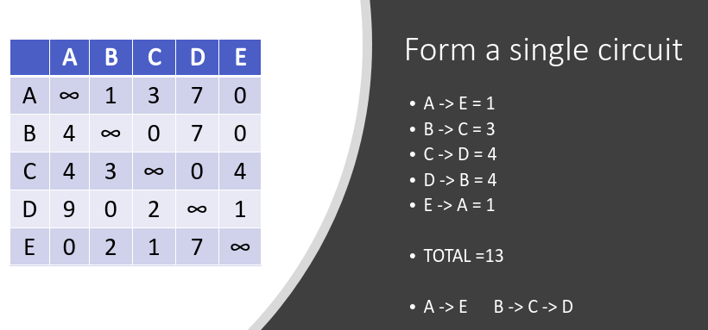
Condition:
to visit each city once and only once, arriving back to city from where started

Slide 15
Branch and bound method​
 | 1 | 2 | 3 | 4
1 | ∞ | 5 | 2 | 3
2 | 4 | ∞ | 2 | 3
3 | 4 | 2 | ∞ | 3
4 | 7 | 6 | 8 | ∞
Row Reduction
Column Reduction
 | 1 | 2 | 3 | 4
1 | ∞ | 3 | 0 | 1
2 | 2 | ∞ | 0 | 1
3 | 2 | 0 | ∞ | 1
4 | 1 | 0 | 2 | ∞
 | 1 | 2 | 3 | 4
1 | ∞ | 3 | 0 | 0
2 | 1 | ∞ | 0 | 0
3 | 1 | 0 | ∞ | 0
4 | 0 | 0 | 2 | ∞
2
2
2
6
​1 | ​ | ​ | 1
Reduced matrix:
Check rows and cols have atleast one zero
Total cost reduced = 12+2 = 14

Slide 16
Reduced Cost = Cost of original matrix + cost of ( i , j ) in original matrix + Total cost reduced
^ ^
C(S) = C(R) + A[i][j] + R
 | 1 | 2 | 3 | 4
1 | ∞ | 3 | 0 | 0
2 | 1 | ∞ | 0 | 0
3 | 1 | 0 | ∞ | 0
4 | 0 | 0 | 2 | ∞
Path(1-2)
Set 1st row ->∞,
2nd col -> ∞,
A[2][1] ->∞
Path(1-3)​
Set 1st row ->∞, ​
3rd col -> ∞, ​
A[3][1] ->∞​
Path(1-4)​​
Set 1st row ->∞, ​​
4th col -> ∞, ​​
A[4][1] ->∞​​
 | 1 | 2 | 3 | 4
1 | ∞ | ∞ | ∞ | ∞
2 | ∞ | ∞ | 0 | 0
3 | 1 | ∞ | ∞ | 0
4 | 0 | ∞ | 2 | ∞
 | 1 | 2 | 3 | 4
1 | ∞ | ∞ | ∞ | ∞
2 | 1 | ∞ | ∞ | 0
3 | ∞ | 0 | ∞ | 0
4 | 0 | 0 | ∞ | ∞
 | 1 | 2 | 3 | 4
1 | ∞ | ∞ | ∞ | ∞
2 | 1 | ∞ | 0 | ∞
3 | 1 | 0 | ∞ | ∞
4 | ∞ | 0 | 2 | ∞
^
C(2) = C(R) + A[i][j] + R​
= 14 + 3 + 0
= 17
^
C(3) = C(R) + A[i][j] + R​​
= 14 + 0 + 0​
= 14
^​
C(4) = C(R) + A[i][j] + R​​​
= 14 + 0 + 1
= 15

Slide 17
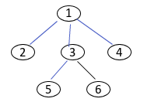
Path(1-3-2)​
Set 1st row,3rd row ->∞, ​
2nd col -> ∞, ​
A[3][1] & A[2][1] ->∞​
1
Path(1-3-4)​
Set 1st row, 3rd row ->∞, ​
4th col -> ∞, ​
A[3][1] & A[4][1] ->∞​
2
3
4
 | 1 | 2 | 3 | 4
1 | ∞ | ∞ | ∞ | ∞
2 | ∞ | ∞ | ∞ | 0
3 | ∞ | ∞ | ∞ | ∞
4 | 0 | ∞ | ∞ | ∞
5
6
 | 1 | 2 | 3 | 4
1 | ∞ | ∞ | ∞ | ∞
2 | 1 | ∞ | ∞ | ∞
3 | ∞ | ∞ | ∞ | ∞
4 | ∞ | 0 | ∞ | ∞
Path(1-3-2-4)​​
Set 1st row,3rd row, 2nd row ->∞, ​​
4th col -> ∞, ​​
A[3][1], A[2][1] & A[4][1] ->∞​​
^​
C(5) = C(R) + A[i][j] + R​​
= 14 + 0 + 0​
= 14
^​
C(6) = C(R) + A[i][j] + R​​
= 14 + 0 + 1​
= 15
 | 1 | 2 | 3 | 4
1 | ∞ | ∞ | ∞ | ∞
2 | ∞ | ∞ | ∞ | ∞
3 | ∞ | ∞ | ∞ | ∞
4 | ∞ | ∞ | ∞ | ∞
 | 1 | 2 | 3 | 4
1 | ∞ | ∞ | ∞ | ∞
2 | 1 | ∞ | ∞ | 0
3 | ∞ | 0 | ∞ | 0
4 | 0 | 0 | ∞ | ∞
^​
C(7) = C(R) + A[i][j] + R​​
= 14 + 0 + 0
= 14
7

Slide 18
Ref: Travelling Salesman problem in Operations Research using Hungarian Method : by kauserwise

